Slide 1
ANDROID BASED E-VOTING SYSTEM
Undertaken By:
Muhammad Nadeem
Reg. No. CIIT/FA20-bse-035/ Vehari
Muhammad Usman
Reg. No. CIIT/FA20-bse-055/ Vehari
Supervised By:
Sir NASHIT ALI

Slide 2
INTRODUCTION
Welcome to the future of voting! Our Android-based solution is poised to transform
elections, simplifying the process through a mobile app.
With facial recognition and fingerprint authentication, we ensure secure voting.
Our aim? To increase voter participation by offering convenience and real-time results. Plus, our app enables users to validate their votes, ensuring transparency and accountability
System Introduction
Background of the System

Slide 3
Objectives of the System
The objectives of the Android-based e-voting system are as follows:
To create a user-friendly mobile application for eligible voters to cast their votes conveniently.
To enhance the security of the voting process by implementing advanced authentication and encryption mechanisms.
To provide real-time results and analytics for election administrators.
To reduce the administrative burden of managing paper ballots and manual vote counting.
To improve accessibility for voters with disabilities through inclusive design features.
To support multiple types of elections, including government, academic, and corporate elections

Slide 4
Significance of the System
Efficiency and Speed
Reduced Errors and Fraud
Enhanced Transparency
Cost Efficiency
Environmental Impact
REQUIREMENT SPECIFICATIONS
Product Scope
The Android e-voting system made with Flutter needs to focus on making voter registration smooth and secure. It should use strong security measures like encryption and multi-factor authentication to protect against hacking. The interface should be easy to use on any device, and biometric verification can ensure that only eligible voters can cast their votes securely. The system should accurately record votes and keep a clear record of the process for transparency. It should also be accessible to people with disabilities.

Slide 5
Product Description
Product Functionality
Voter Authentication
Ballot Casting
Ballot Verification
Security Measures
Audit Trail
Accessibility Features
Scalability and Reliability
Users and Characteristics
Users of E-Voting Systems:
Voters
Election Administrators
IT Professionals

Slide 6
Characteristics of E-Voting Systems
Accessibility
Security
Accuracy
Transparency
Auditability
Usability
Scalability

Slide 7
Specific Requirements
Functional Requirements
Administrator module:
Admin Login with facial recognition authentication.
Add Voters Data.
Edit/delete candidates’ particulars.
Create a poll/election.
Provide a database having voters’ information.
Edit/delete voter’s information in the database.
Provide database having the total number of casted votes.
Produce a report or analysis based on the total casted votes and voting ratio etc. statistically in a graphical view.
Produce detailed report demographically and based on the male/female voting ratio.

Slide 8
Voter Module:
Connect to the system through the Android application.
Sign up for cast vote o Login for voting with facial recognition authentication.
Cast a vote in favor of a candidate/subject.
Voting Module:
Can view the results after polling time.
Produce a report on total casted votes and voting ratio.
Produce a report based on demographics and the male/female voting ratio.
Publish Results

Slide 9
Real-time Updates:
Display real-time updates on the progress of the election, including the number of votes cast and interim results.
Data Backup and Recovery:
Regularly back up voting data, and in the event of a system failure, implement a reliable data recovery mechanism.

Slide 10
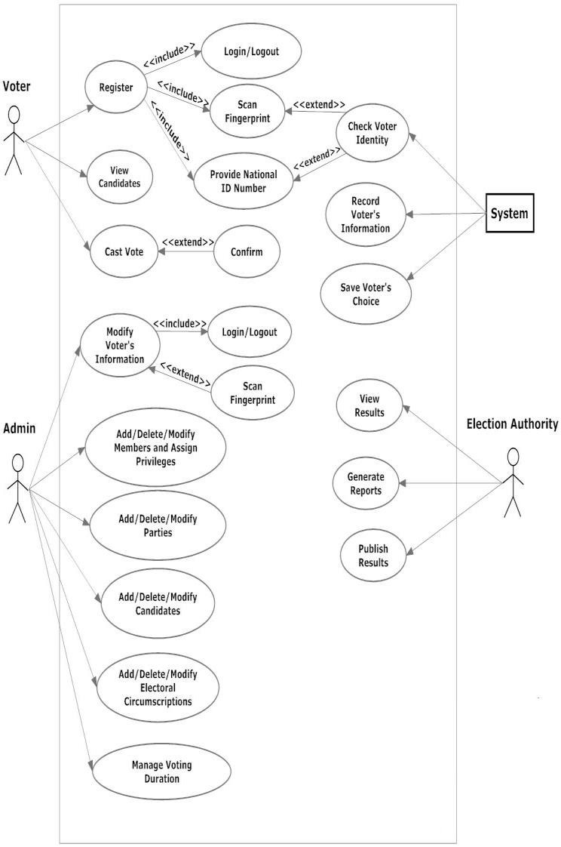
Behavioral Requirements

Slide 11
User Authentication and Authorization
Real-time Monitoring and Reporting
User Feedback and Support

Slide 12
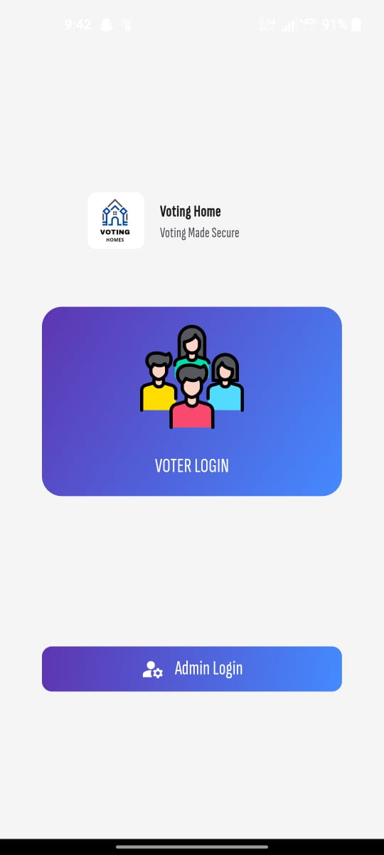
External Interface Requirements

Slide 13
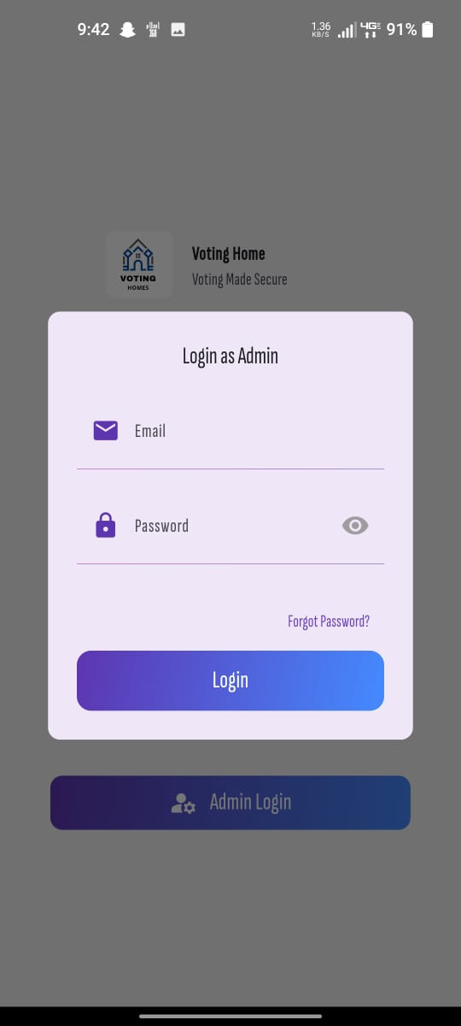

Slide 14
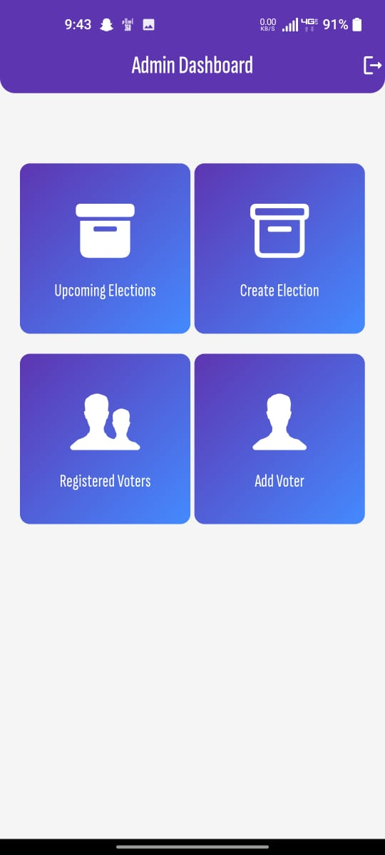

Slide 15


Slide 16
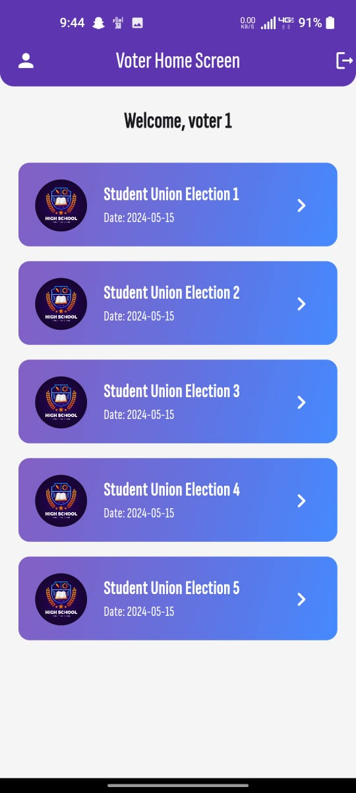

Slide 17
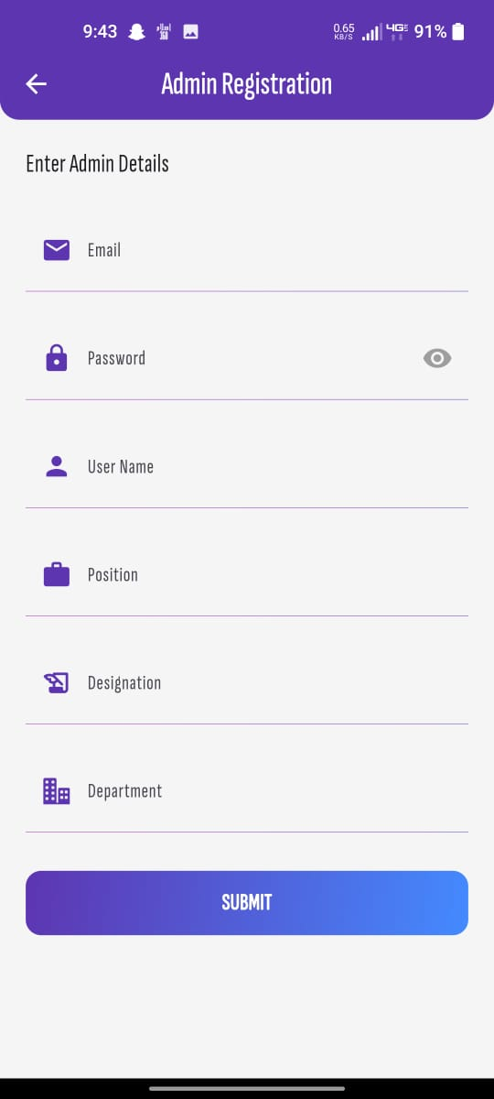

Slide 18
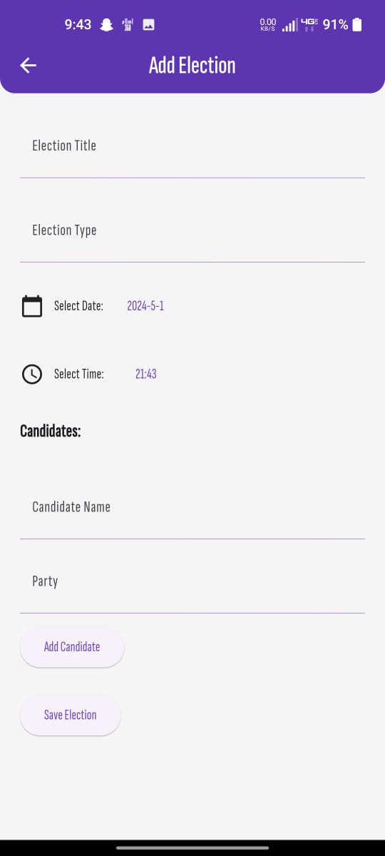

Slide 19
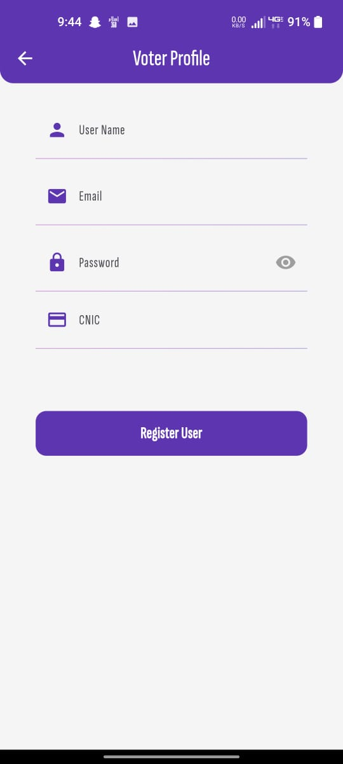

Slide 20
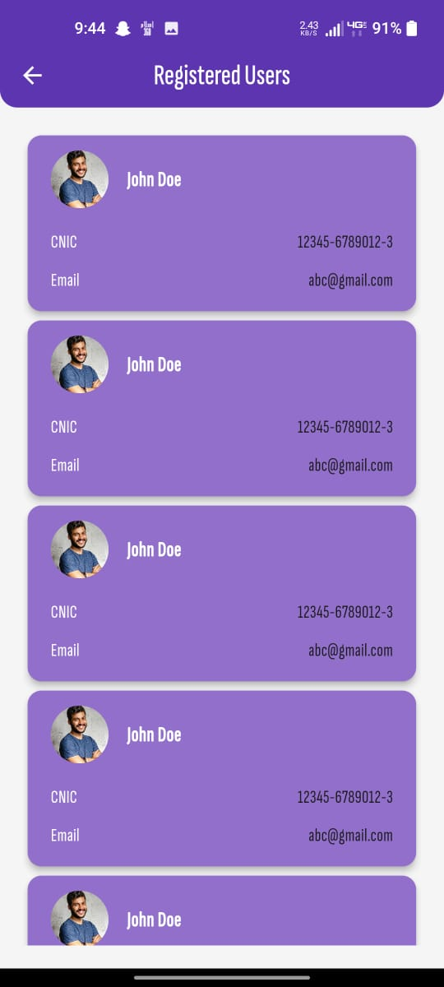

Slide 21
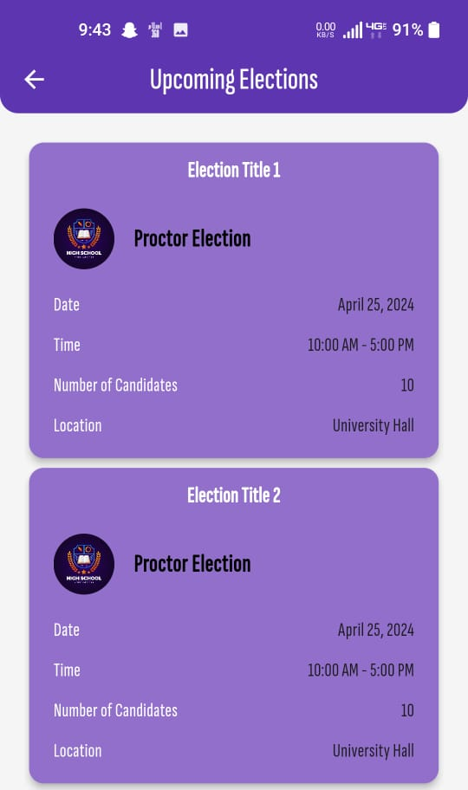

Slide 22
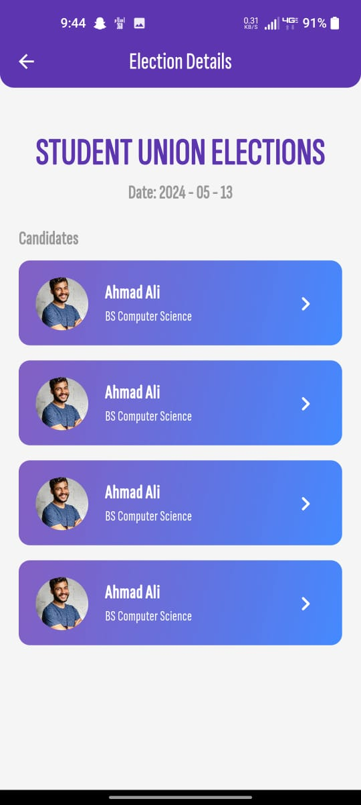

Slide 24
User Interface
Voter Registration Interface
Biometric Verification Systems
Government Identity Databases
Other Interfaces (if any)
Hardware Interfaces:
Voting Machines or Devices
Smart Cards or Tokens
Network Infrastructure
Software Interfaces
Voter Registration System
Biometric Verification Software
Election Commission Database

Slide 25
Non-functional Requirements
Performance Requirements
Scalability
Response Time
Concurrency Handling
Reliability and Availability
Data Transfer Efficiency
Safety and Security Requirements
Authentication verify
Encryption
Secure Transmission
Auditability and Transparency
Multi-factor Authentication
Backup and Recovery
Regulatory Compliance

Slide 26
DESIGN SPECIFICATIONS
This chapter provides an overview of the design specifications for the "Android Based
E-voting system" project. It includes sections on the introduction, composite viewport, logical viewpoint, information viewpoint, interaction viewpoint, and state dynamic viewpoint.
Use case diagram
Class diagram
Sequence diagram
ER diagram
State dynamic diagram

Slide 27
Development Tools
For the development of the "Android Based E-Voting System" project, the following tools and IDEs were utilized:
Programming Languages:
Dart: Used for frontend development.
Frameworks:
Flutter: Utilized for building the frontend user interface.
Database Management System:
Firebase: Chosen as the relational database system for data storage and retrieval.
Version Control:
Git: Utilized for version control and collaborative development.
Integrated Development Environments (IDEs):
Visual Studio Code: Used as the primary IDE for coding and debugging.
Android Studio: Employed for Flutter app development and testing on Android devices.

Slide 28


